Slide 2
Contents
Problem Statement
Proposed Solution
Unsupervised Learning with Autoencoder
Working Conditions
Data Preprocessing
Image Alignment
Structural Similarity
Clustering Algorithm
Aggregate Detection
Results Discussion – Performance
Results Discussion – Times
Conclusions and Future Developments

Slide 3

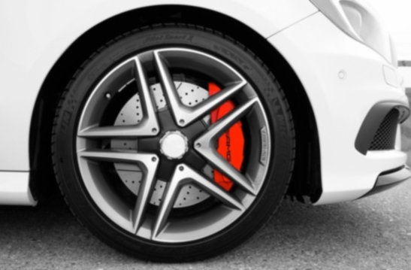
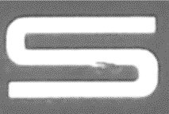
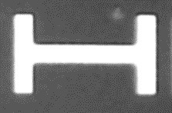
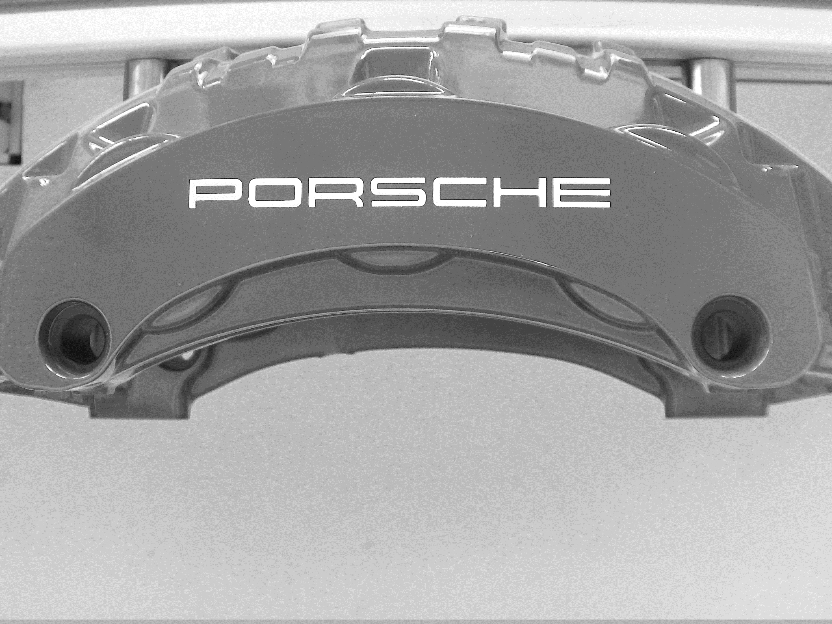
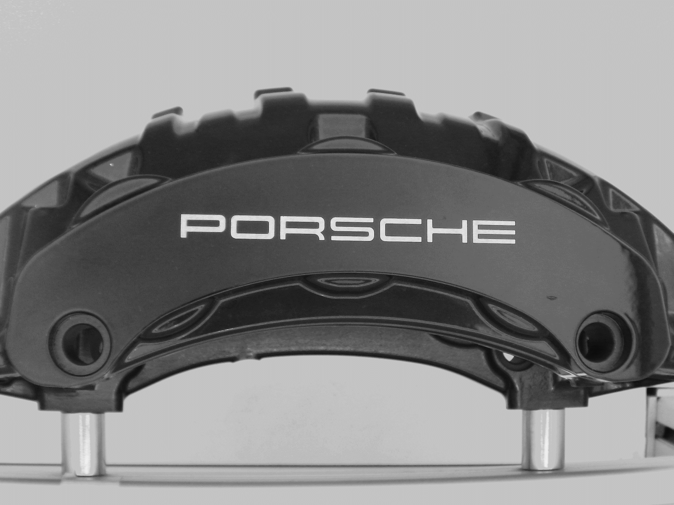

Problem Statement
Image provided by ClickMechanic
Automate industrial quality control on brake calipers using machine learning techniques.
In industrial production, components can often become damaged, leading to their rejection if they do not perform their function properly or do not meet aesthetic standards.
Traditional quality control is based on manual inspection.
Now, with AI algorithms, this process can be faster and more efficient.
Images acquired in Gefit, Alessandria
Notes:
Before going deeper into the specifics of our research, I’d like to provide you with some background context and explain the motivation behind this study. Our goal is to provide assistance to manual labour in industrial quality control using ML techniques.
In industrial production, components such as brake calipers can often sustain damage, leading to potential rejection. As we know, brake calipers are essential for vehicle safety, but they also hold aesthetic importance expecially in luxury vehicles, where every detail contributes to the overall image of prestige
Until now, traditional quality control methods rely heavily on manual inspection which is time-consuming and prone to human error
But now, with the advancement of AI algorithms, we have to opportunity to revolutionize this process, making it faster and more efficient.
Here are reported some examples of defects found on brake calipers’ surface, such as deformities, bubbles and scratches.

Slide 4
Proposed Solution
Dataset Acquisition
Model Training
Model Evaluation
Image Preprocessing
Develop an automatic defect detection system capable of identifying imperfections such as deformities, bubbles, and scratches.
1
2
3
Train a Convolutional Autoencoder on images of defect-free brake calipers, aiming to reconstruct test images and identify defects.
Apply a difference function to compare original and reconstructed images, identifying potential defects based on contrast, brightness, and structure.
Use a clustering algorithm to categorize detected areas as either defects or non-defects.
Notes:
Our proposed solution consists on a 3-step approach:
First we trained a CAE on a dataset of defect-free brake calipers’ images with the aim of reconstructing test images
Next, we applied a difference function to each couple of original and reconstructed image. By a comparison on contrast, luminance and structure, we can pinpoint potential defects
Finally, we employed a clustering algorithm to distinguish the actual defects from reconstruction errors that can sometimes happen

Slide 5
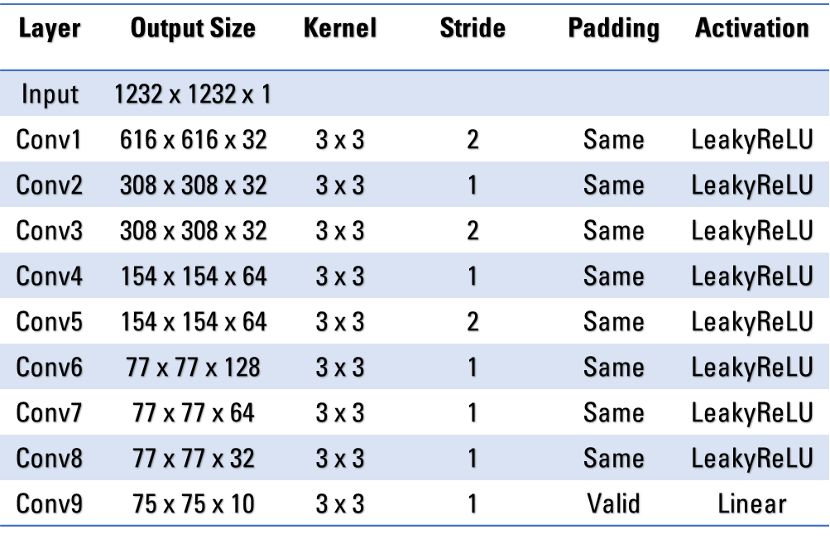
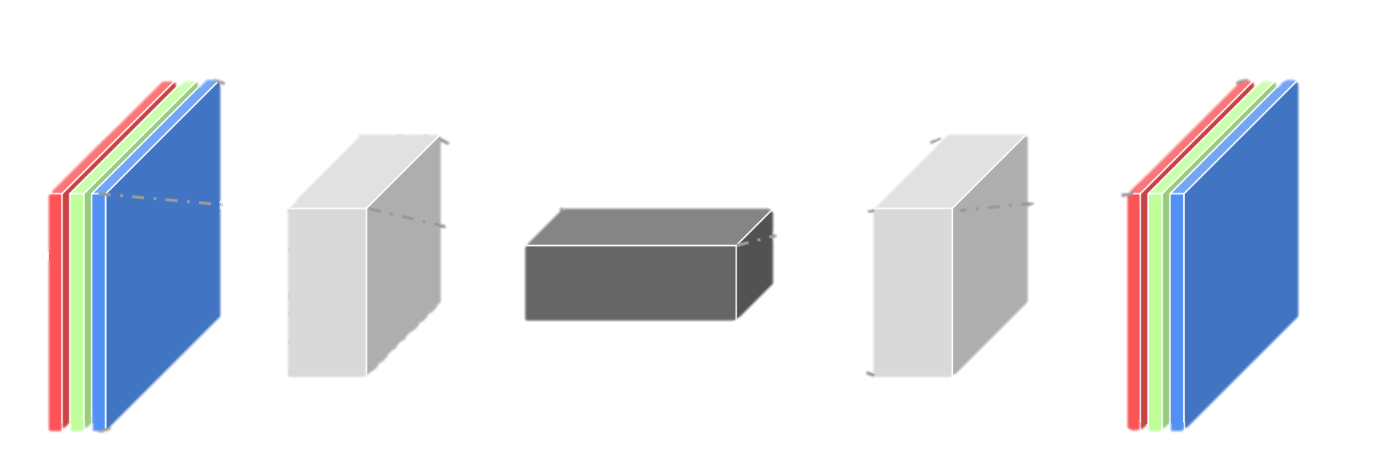


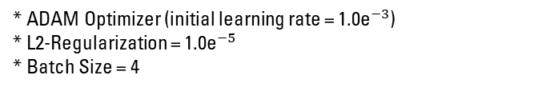
Unsupervised Learning with Autoencoder
Autonomous Pattern Discovery
Ideal for limited and unlabeled data.
Scalability
Handle large datasets effortlessly without the burden of manual labeling.
Adaptability
Stay ahead of evolving defect patterns with flexible learning.
* ADAM Optimizer (initial learning rate = ${\text{1}\text{.}\text{0}\text{e}}^{−3}$)
* L2-Regularization = ${\text{1}\text{.}\text{0}\text{e}}^{−5}$
* Batch Size = 4
Input Image
Transpose
Conv
Reconstructed Image
Conv
Latent Space Representation
Autoencoder Reconstruction
Inspired by P. Bergmann, S. Lowe, M. Fauser, D. Sattlegger, and C. Steger. «Improving Unsupervised Defect Segmentation by Applying Structural Similarity to Autoencoders»
Notes:
Let’s now discuss the main benefits of using an unsupervised learning approach with autoencoder.
Autoencoders provide APD capability: this means they are able to discover hidden patterns within the data without the need of a very large dataset
Moreover, they can easily be adapted to larger dataset because there is not burden of manual labeling
Furthermore, they provide adaptability to new defect patterns, which is a crucial aspect in our task
Let’s now take a closer look to the autoencoder’s architecture; in this table is reported the encoder structure. It is composed of 9 Conv layers, designed to gradually reduce the output size of the input image. By a careful selection of kernel size, S, P and AFs, we were able to compress the input image while retaining relevant information for our task.
On the bottom part of the slide, we can see on the right an illustration of autoencoder’s reconstruction on a logo patch taken from a defective caliper and it is shown the efficacy of reconstruction.
But before understanding how the difference function works to highlight this kind of defects, …

Slide 6
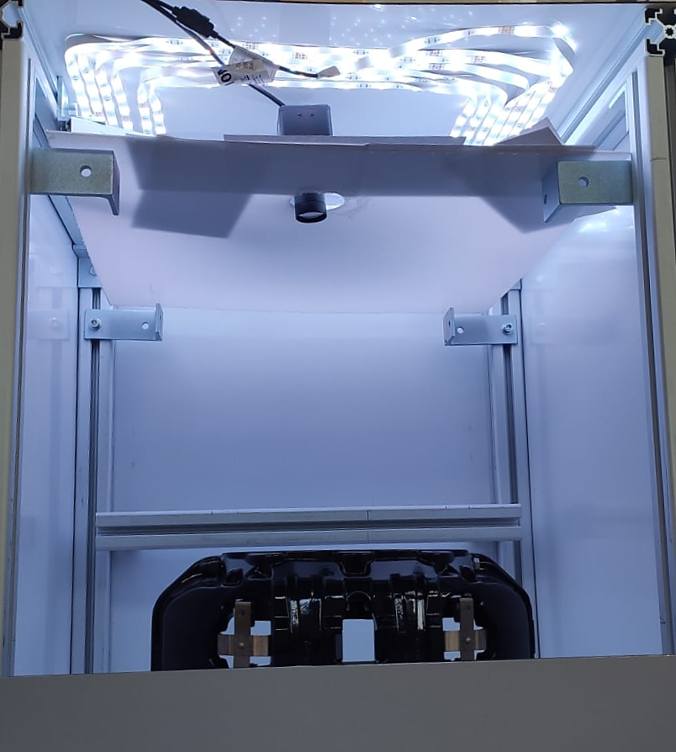
Working Conditions
Workbench enclosed on three sides and top.
External light variability.
Internal adjustable LED lighting.
Variations in positioning and lighting over time.
Image acquired in Gefit - Alessandria
Notes:
… it is important to see the working conditions in which the brake calipers’ images were acquired.
The workbench provided by Gefit is shown in this image and is enclosed on 3 sides and the top, providing a controlled environment.
However, from the open side, it has demostrated that an external light enters into the workbench, which is not trascurable. This light suffers from some variability, expecially sunlight variability and artificial lighting that changes from time to time.
To mitigate this variability, into the workbench has been implemented internal adjustable LED lighting
We also encounter challenges in brake caliper’s positioning, in addition to the ones in lighting, because the process of manual brake caliper’s insertion into the workbench is not perfectly reproducible.

Slide 7

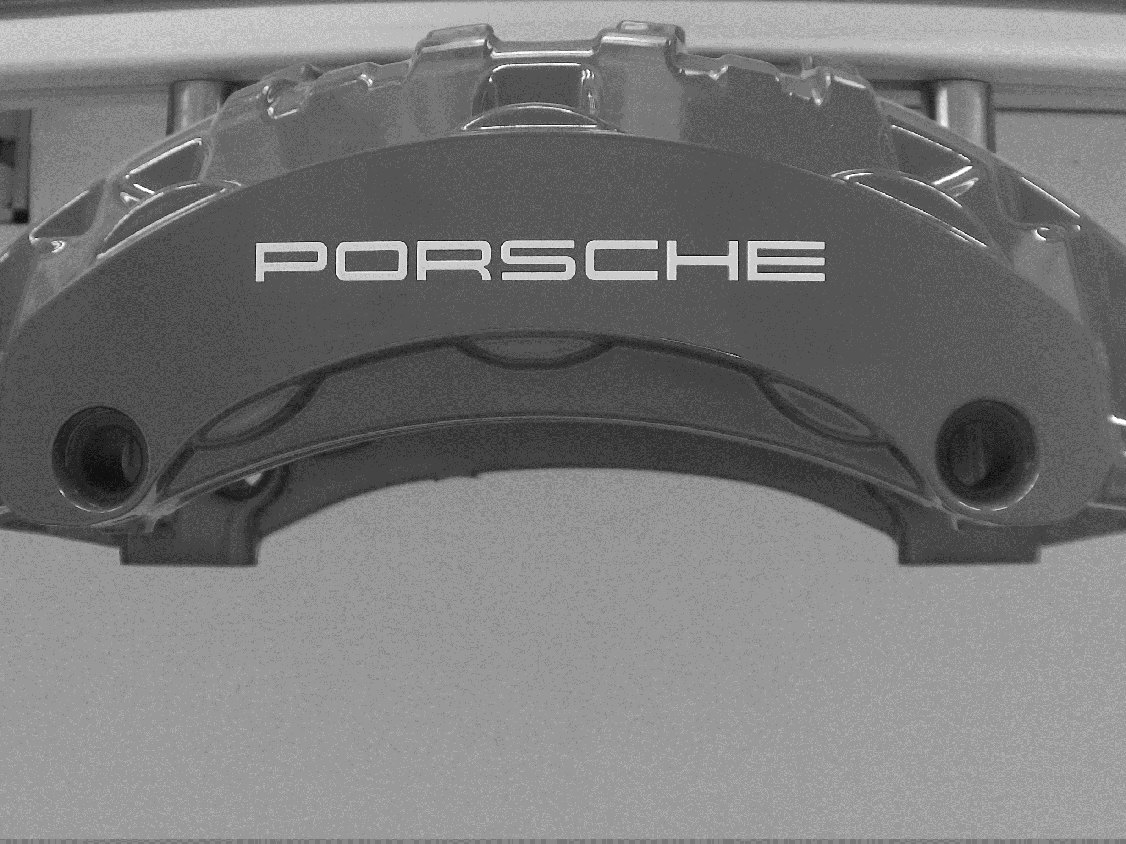
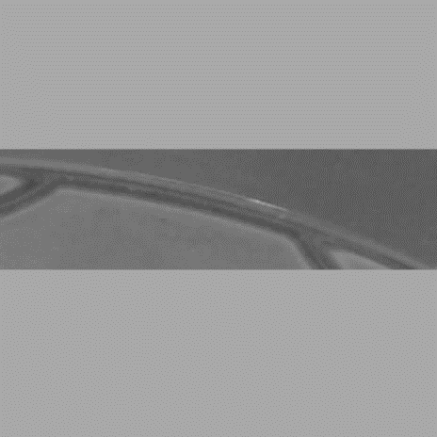
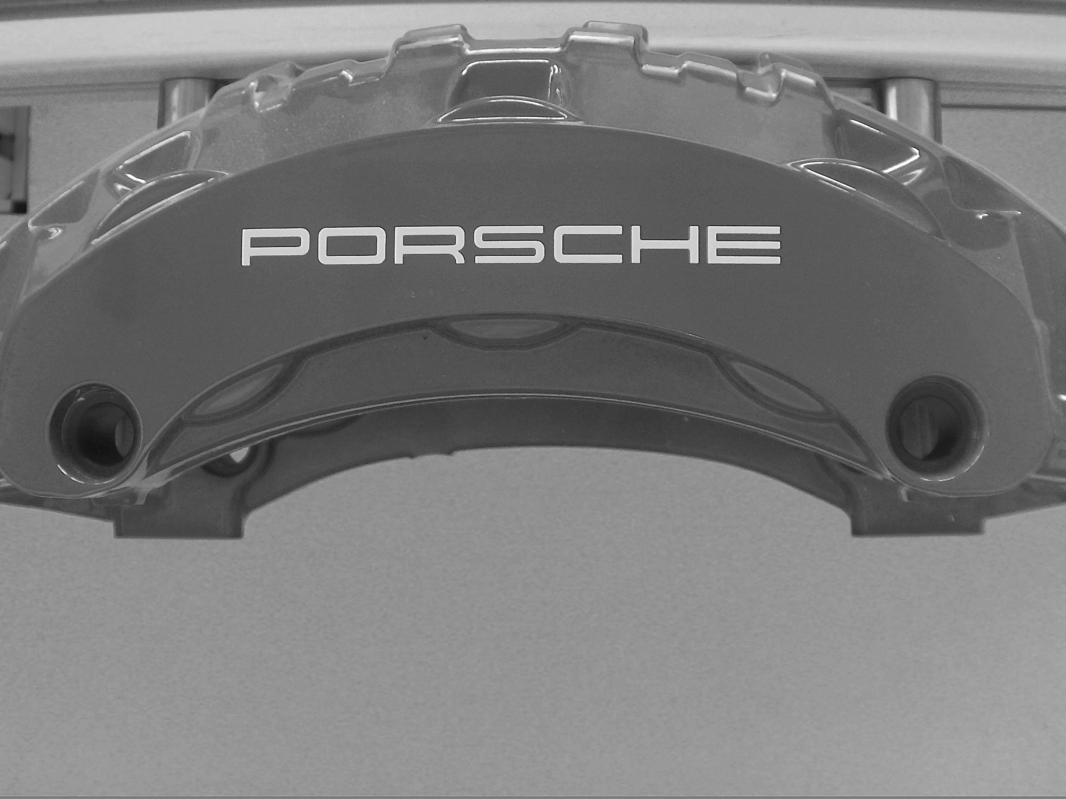
Data Preprocessing
Each brake caliper was photographed 15 times under variable illumination.
Transformations on each acquired image:
Grayscale conversion
Blurring
Cropping & Padding
Logo image patch
taken from an original image
of the training dataset
Example of augmented patch
with rototranslation and
contrast + brighntess
Data Augmentation Transformation | Training Dataset Composition
None | 6%
Translation | 19%
Rotation | 12%
Rototranslation | 13%
Contrast & Brightness | 50%
Image patch of a nonlinear area
taken from an original image
of the training dataset
Example of augmented patch
with contrast + brighntess
Images acquired in Gefit - Alessandria
Notes:
Taking care of the inherent variability of our workbench, we strategically designed a data preprocessing pipeline.
For this purpose, each brake caliper was acquired from 10 to 15 times under variable LED lighting conditions.
The preprocessing pipeline consists in different transformations
Each image underwent GC to reduce model’s complexity by removing one channel
Then blurring was applied to reduce the image noise
Finally, in order to focus on a particular area of the brake caliper, the image is cropped and padded to be squared and be ready to be passed as input to the autoencoder
To better improve model’s generalization, different data augmentation strategies were employed and are listed in the table with their relative percentage of TDC. For example, rototranslation was effective because it allows to replicate the process of brake caliper’s manual insertion into the workbench

Slide 8
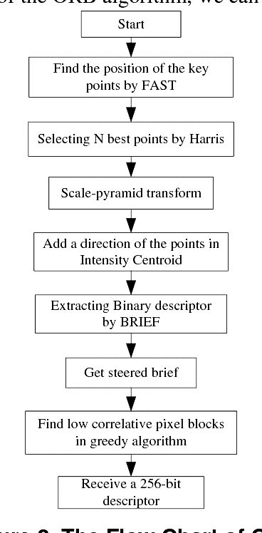
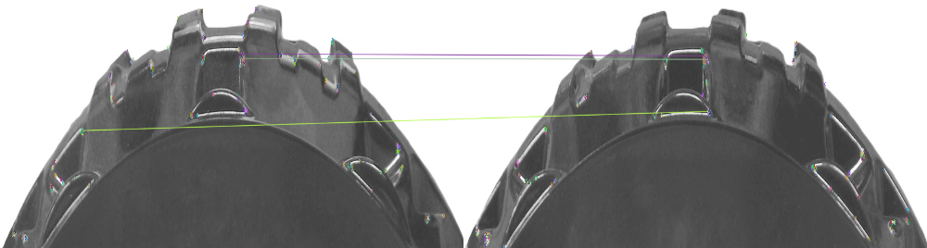
Image Alignment
Image taken from Wan Zaki et al. «Moving object detection using keypoints reference model»
Based on translation, rotation, and uniform scaling.
ORB algorithm (Oriented FAST and Rotated BRIEF)
Rotates the BRIEF (Binary Robust Independent Elementary Features) according to the orientation of keypoints, depending on how the levels of intensity change around the keypoint.
Brute-Force Matcher
Takes each descriptor of the template image and matches to all the descriptors of the new image.
Image returned by cv2.drawMatches OpenCV function
Notes:
But what happens if the variability during the real time production cycle is too high to be incorporated into the training dataset, because, for example of the limited computational resources at our disposal?
Image alignment may be an effective solution: this process consists in taking each testing image and aligning it to another brake caliper’s image, previously acquired, taken from the training dataset, by applying translation, rotation and uniform scaling transformations.
To reach this goal we employed ORB together with BFM.
The first algorithm processes the keypoints and descriptors previously computed by FAST and BRIEF, as illustrated in the flowchart
Then BFM makes associations between the features of the reference and the new image. In the image here are reported the top 3 feature matchings and you can see the 2 are correct because they point to the same BC regions, but the one drawn with the green line is not. Taking a larger sample has been demonstrated to reach satifactory results for our task even though it struggles with some associations.

Slide 9
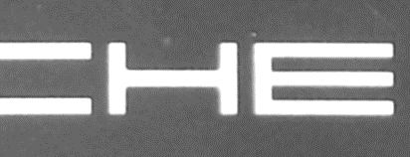
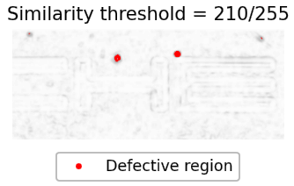
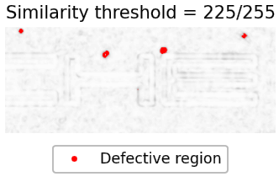


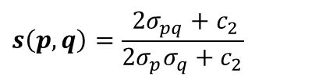
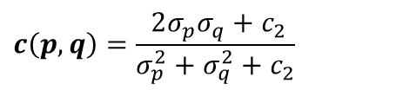
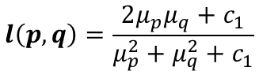
Structural Similarity
SSIM defines a distance measure between the original image patch $p$ and its reconstruction $q$.
$$SSIM\left(p, q\right)=l\left(p, q\right) c\left(p, q\right) s\left(p, q\right)=\frac{(2μ_{p}μ_{q}+c_{1})(2σ_{pq}+c_{2})}{(μ_{p}^{2}+μ_{q}^{2}+c_{1})(σ_{p}^{2}+σ_{q}^{2}+c_{2})}$$
$μ_{p}$, $μ_{q}$ : patches’ mean intensities
$σ_{p}^{2}$, $σ_{q}^{2}$ : patches’ variance intensities
$σ_{pq}$ : patches’ covariance
$$p$$
$$q$$
Luminance:
$$l\left(p, q\right)=\frac{2μ_{p}μ_{q}+c_{1}}{μ_{p}^{2}+μ_{q}^{2}+c_{1}}$$
$$c\left(p, q\right)=\frac{ 2σ_{p}σ_{q}+c_{2}}{σ_{p}^{2}+σ_{q}^{2}+c_{2}}$$
Contrast:
$$s\left(p, q\right)=\frac{ 2σ_{pq}+c_{2}}{2σ_{p}σ_{q}+c_{2}}$$
Structure:
Images acquired in Gefit - Alessandria
Notes:
Let’s now explore the keypoint of our detection model which is responsible to find candidates for defects. It is based on the SSIM computation, which quantifies the similarity between an original image and its reconstruction.
Illustrated in this slide there is a logo patch example taken from a defective brake caliper where there are two more prominent defects and two less visible. The image labeled as «p» is the original image, while «q» is its reconstruction. Below are visualized two similarity maps, whose pixels values are computed by the formula shown above, which is a product of luminance, contrast and structure. The user has the possibility of setting a threshold, such that all the pixels with a similarity value less or equal the value written in the caption are drawn in red and are considered possible candidates for defects. You can see that setting a higher threshold allows to consider also the more subtle defects.

Slide 10
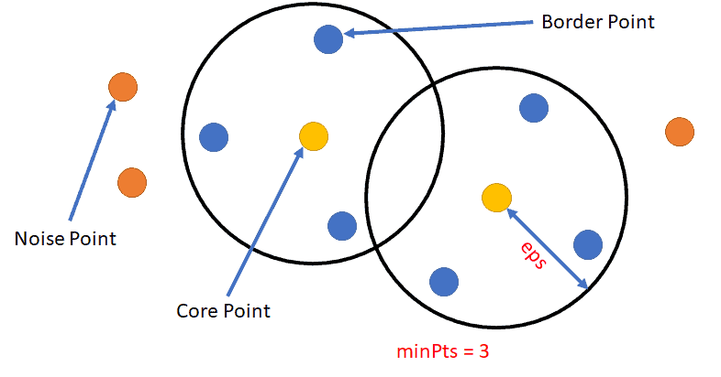
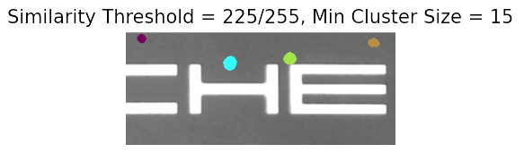
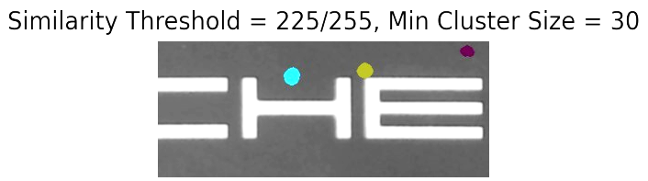
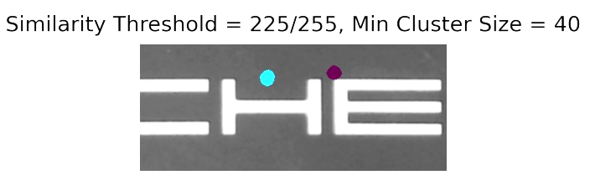
Clustering Algorithm
Why DBSCAN?
Density-Based Spatial Clustering Of Applications With Noise.
Defects in brake calipers can be clusters of arbitrary shape.
Distinguish the real defects from the reconstruction errors.
Images acquired in Gefit - Alessandria
Notes:
To make an effective distinction between actual defects and reconstruction errors comes to help the clustering algorithm.
The choice of DBSCAN is motivated by several reasons; the most important is that it doesn’t require to specify a priori a cluster’s shape. This is crucial for our scenario, in which the morphologies of our defects are not classifiable apriori into pre-defined labels.
DBSCAN requires to specify two parameters:
Epsilon, which is the maximum distance of a border point to the core point
Min cluster size, which defines the minimum number of points that must contain a cluster
Taking the logo example shown before, we can see that increasing the MCS parameter allows to focus only on more prominent defects.

Slide 11
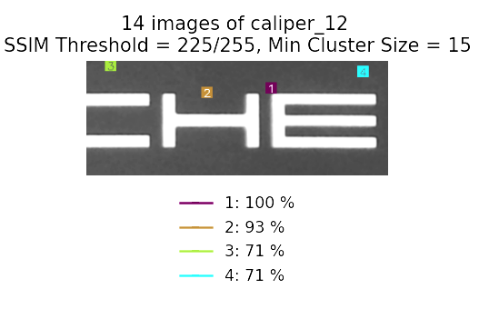
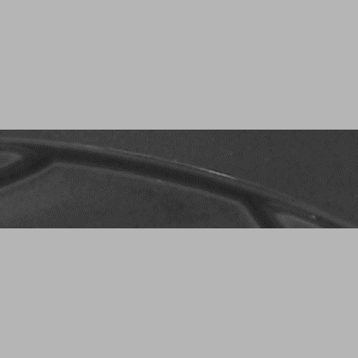
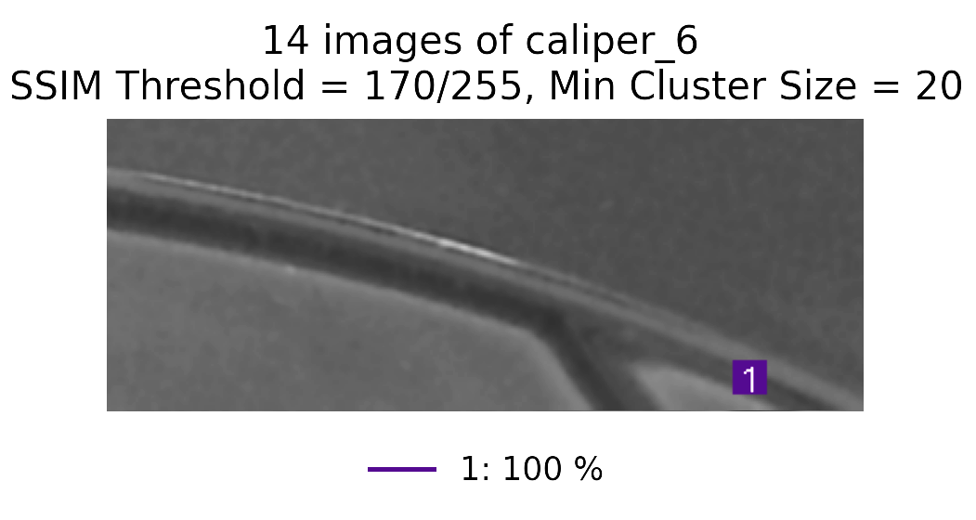

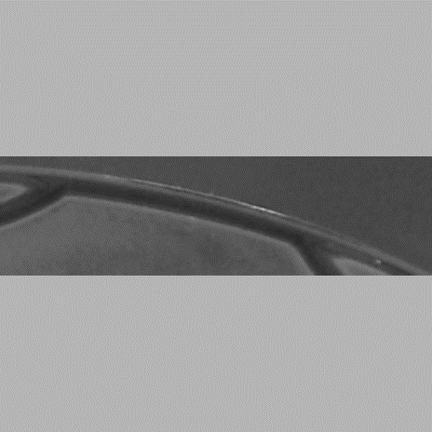
Aggregate Detection
Not all the defects are visible under the same luminance condition.
Dynamic LED setting: the results are the combination of multiple acquisitions of the same brake caliper.
…
…
Images acquired in Gefit - Alessandria
Notes:
Since it was observed that some defects are visible only under certain luminance condition, we’ve designed the aggregate defect detection process.
It consists in merging the results coming from the detections of different acquired images of the same brake caliper taken into variable LED lighting conditions. The final visualization displays the different defects with their relative percentage of detection over the total number of images.
Focusing on the logo example that we’ve already seen before, we can see that the two more prominent defects have been found in almost all the photos, while the two more subtle not. This demonstrates the reliability and the effectiveness on this approach

Slide 12
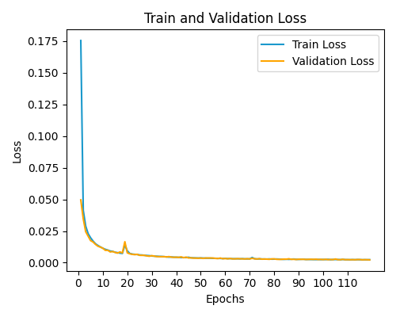
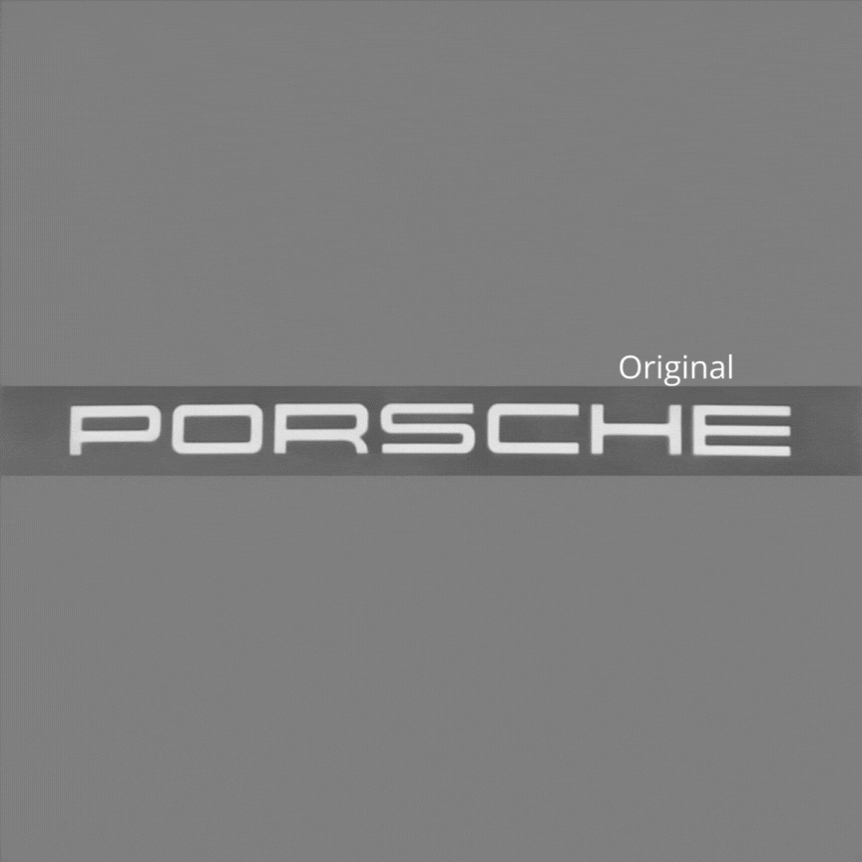
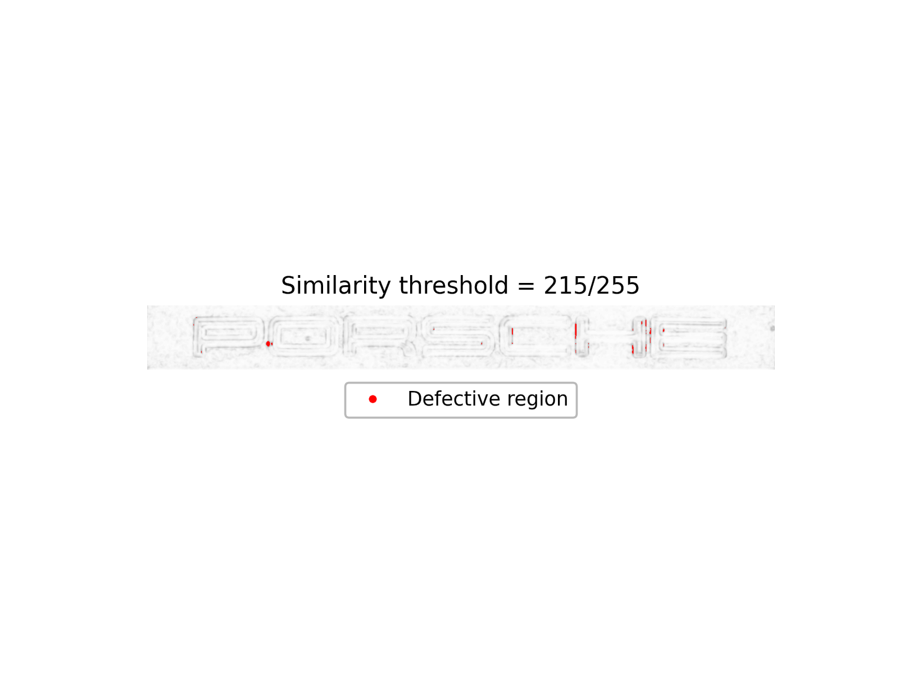

Results Discussion (1)
Simulation of a Real-time Production Cycle on the Logo Region
Brake Caliper Id | Num Images | Real Defects | TPs Mean | FPs Mean | FNs Mean | Recall | Precision | F1Score
1 | 14 | 1 | 1 | 0 | 0 | 1 | 1 | 1
2 | 16 | 2 | 1.93 | 0.50 | 0.06 | 0.97 | 0.79 | 0.87
3 | 14 | 2 | 1.86 | 0.14 | 0.14 | 0.93 | 0.93 | 0.93
4 | 17 | 2 | 1.94 | 0 | 0.06 | 0.97 | 1 | 0.98
5 | 14 | 2 | 1.79 | 0.21 | 0.21 | 0.90 | 0.90 | 0.90
6 | 12 | 1 | 1 | 0.08 | 0 | 1 | 0.93 | 0.96
7 | 13 | 2 | 1.15 | 0 | 0.85 | 0.58 | 1 | 0.73
8 | 16 | 4 | 3.93 | 0.13 | 0.06 | 0.99 | 0.97 | 0.98
False Positive
False Negative
Notes:
Let’s now have a look to the insights collected in a simulation of a real-time production cycle on the logo region. The analysis takes 8 different defective brake calipers under detection.
Evaluating the results by the recall, precision and F1-score metrics generally suggests a good performance, except some cases that deserve a deeper understanding:
Specifically, the precision of Brake Caliper 2 is not one of the best and this is the direct consequence of the presence of FPs indicated in the similarity map shown here. They suggest that the model slightly overfits the training dataset, such that the model makes too precise reconstructions, expecially in the borders regions
On the contrary, the low recall of BC 7 is caused by the presence of FNs shown in the other image. This is a very subtle defect and the model can sometimes struggle to detect such kind of defects.
The challenge consists in minimizing both False Positives and False Negative by choosing the best values for similarity threshold and clustering algorithm.

Slide 13


Results Discussion (2)
Time for Training
118 epochs for training 688 images of size 1232 x 1232 x 1 ~ 18.3 h.
Times for Inference
Time for reconstructing a 1232 x 1232 x 1 original frame ~ 0.30 s.
Time for computing SSIM Map between two 1232 x 1232 x 1 images ~ 0.30 s.
Throughput of an entire Production Cycle ~ 40 images / min.
Hardware Setup
CPU: Intel(R) Core(TM) i5-8250U CPU @ 1.60GHz 1.80 GHz.
RAM: 8.00 GB.
Notes:
For what concerns the computational times, they strictly depend on the hardware setup used, that is listed here.
The total time taken to reconstruct an image of logo region’s size and to compute its similarity map equals about 0.6 seconds.
It follows that to complete the entire production cycle of the 8 brake calipers that we’ve seen before it takes about 3 minutes.

Slide 14





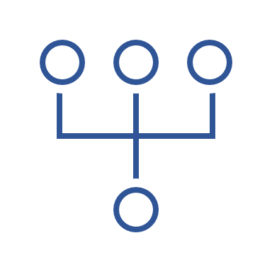


Conclusions and Future Developments
Robustness Across Different Brake Caliper Regions
Beyond Testing: A Software Solution for Pipeline Management
Higher Efficiency and Productivity
Reduced Production Time
Using a Broader Training Dataset
Testing Batch or Group Normalization
Improving Acquisition Consistency
Multi-Camera Setup for Detection on the Entire Brake Caliper
Notes:
Exploring this research path has been challenging:
Starting from the logo region, we’ve showcased the autoencoder’s robustness across different brake caliper’s regions
Going beyond testing, we’ve developed a software solution for production pipeline management
The outcomes have demonstrated higher efficiency and productivity, coupled with a reduced production time
As we look ahead, the focus lies on
Increasing the size of the training dataset to incorporate more variability
Another trial should rely on testing batch or group normalization layers that can reduce overfitting
Some efforts may focus on improving acquisition consistency to realize a more robust workbench
Finally, Gefit is contemplating a MCS to realize the defect detection on the entire brake caliper

Slide 15


Thanks for your attention

